Slide 1
0 wine gums
8 wine gums
4 wine gums
1 2 3
6 wine gums
1 wine gums
14 wine gums
4 5 6
10 wine gums
5 wine gums
3 wine gums
7 8 9

Slide 2


WALT :
Who are the most famous inventors in History and what did they invent?
WILF :
Produce a storyboard showing at least five different inventors and their inventions

Slide 3
What is invention?
the creation of something in the mind
a creation (a new device or process) resulting from study and experimentation

Slide 4
What is an inventor?
someone who is the first to think of or make something

Slide 5
What is the process of invention?

Slide 6
Things an inventor needs to be to be a success:

Slide 7
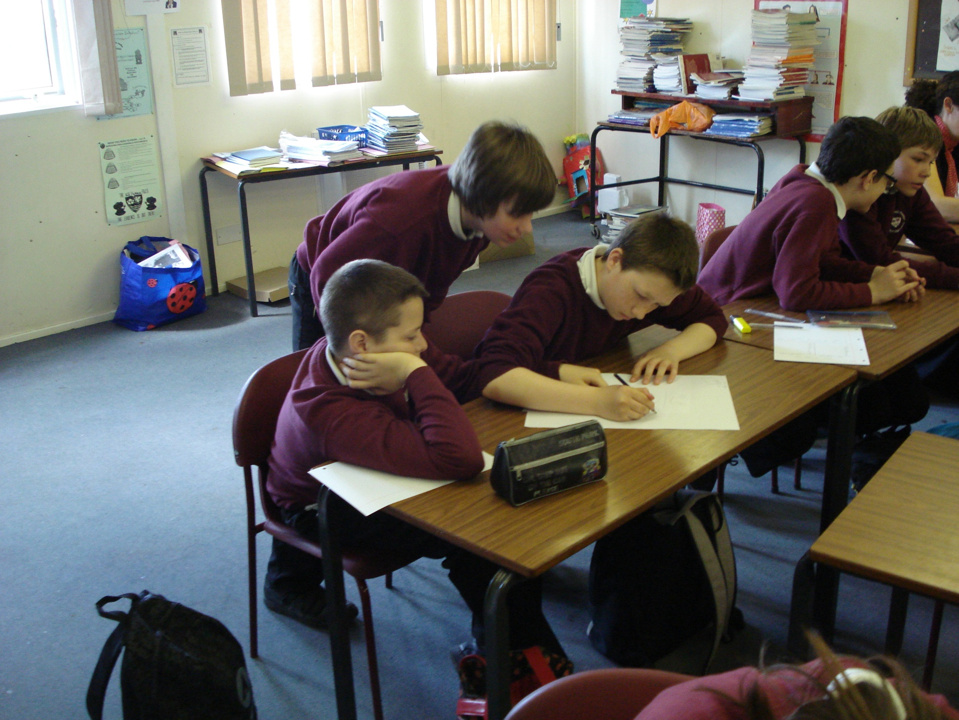

Slide 8
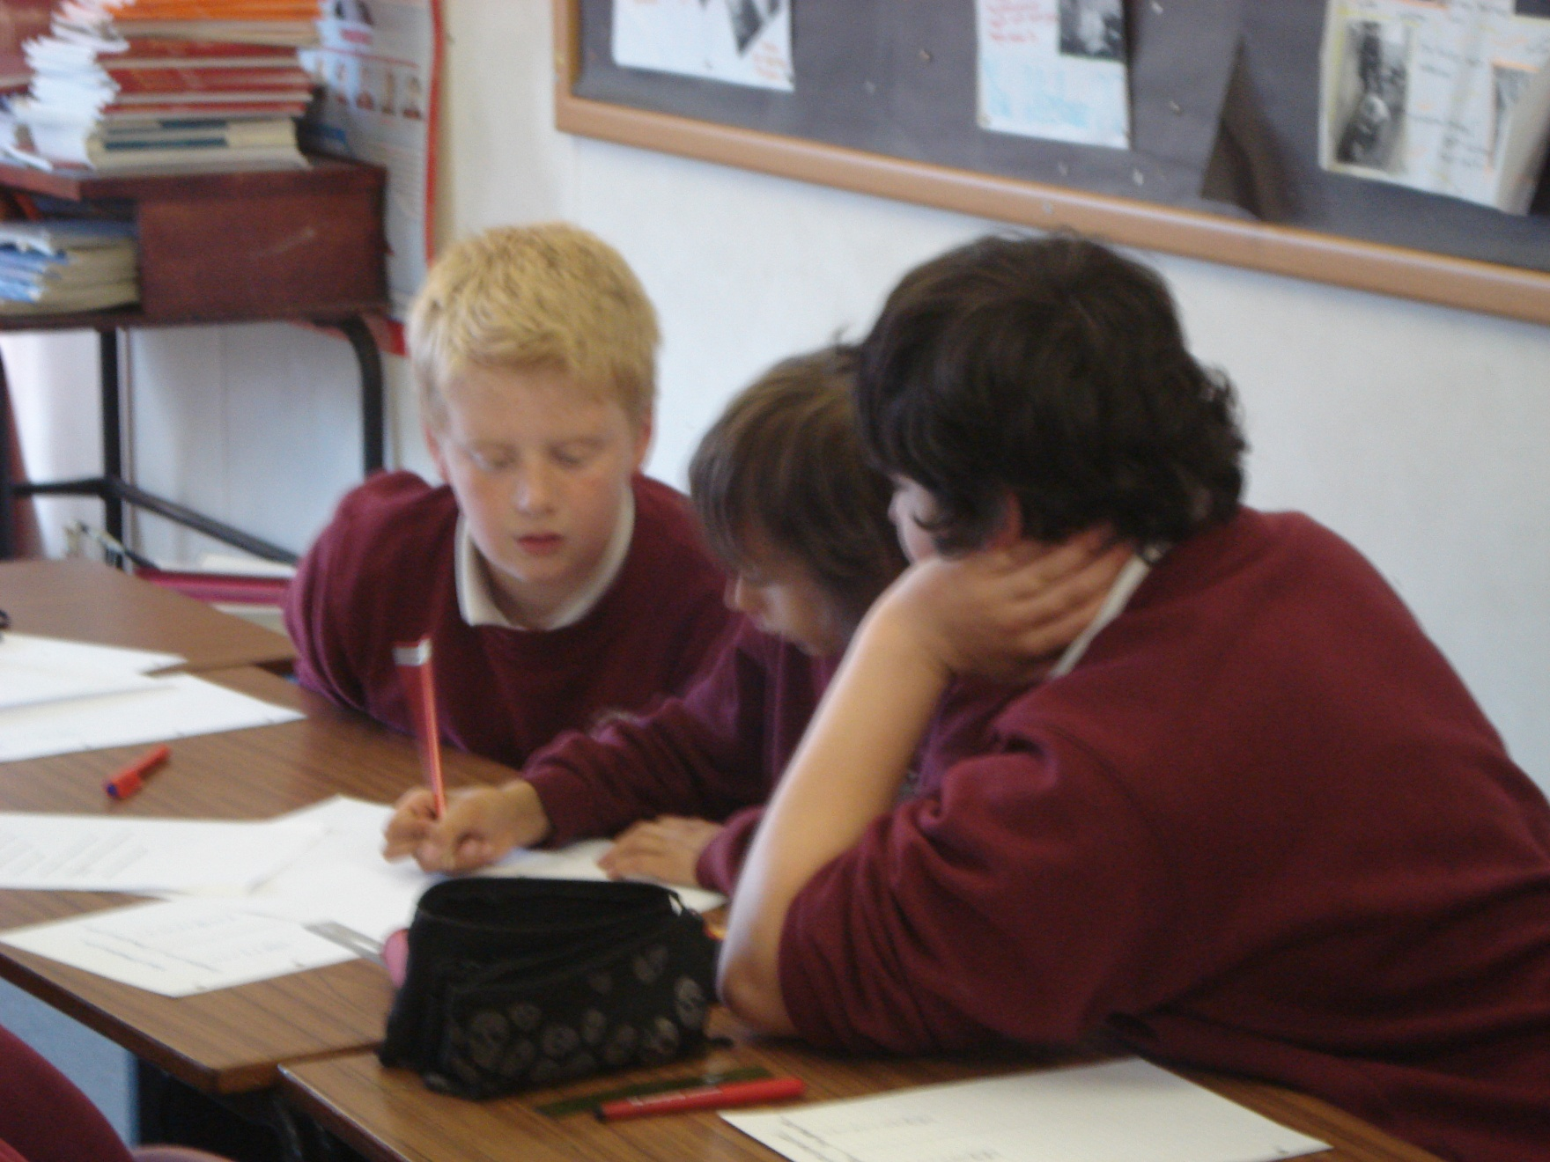

Slide 9

Marketplace

Slide 10
Step 1 (10 minutes)
Read about your inventor
Design a poster using no more than 10 words about your inventor. The poster needs a picture of the invention, the name of the inventor and any other information
Use pictures, symbols, cartoons…etc
Make sure that everybody in your group understands the material
2 facts about the invention/2 facts about the inventor

Slide 11
Step 2 (10 minutes)
One person from your team needs to stay and act as “stallholder”. It is your job to explain the information on your poster to visitors
The rest of the team needs to go out and find the rest of the information and take notes to bring back.
REMEMBER; You need to get as many details about each inventor as you can (there are 7)

Slide 12
Step 3 ( 10 minutes)
Everyone return to your own team.
Now relay all the information you have so that everybody is familiar with it and prepare for the task! (everyone needs a copy of your group’s notes)

Slide 13
TASK
Create a storyboard of at least 5 different inventors to go into your folder at the end of today's lesson

Slide 14
Alexander Graham Bell
Igor Sikorsky
Josephine Cochran
John Harvey Kellogg
Laszio Josef Biro
Robert Adler
Nils Bohlin
Dishwasher
Ballpoint pen
Telephone
Helicopter
Television remote control
Dry breakfast cereal
The seat belt

Slide 15
Task
Create a factfile on famous inventors. You can use the inventors that we looked at in the lesson yesterday but try to use your own through research on the netbook. The more “original” inventions the better.
Minumum – 3 inventors
Good – 5 inventors
Superstar – 7 or more

Slide 16
Each slide/section should include:
Name of invention and image
Some biography of the inventor
What the invention does and how it has changed peoples lives/where it is used

Slide 17
“Back to the future” questions
What has the “doc” invented?
What does it do?
How is it powered?
To what year do they travel back to?
What words would you use to describe the “doc”?

Slide 18
“Back to the future” questions
Does the invention work? Are there any problems with it?
Why did Marty end up back in 1955?
Why is Marty stuck in 1955? (2 reasons)
How does the Doc suggest that Marty gets back to the future?
What does Marty try to persuade George Mcfly to do?

Slide 19
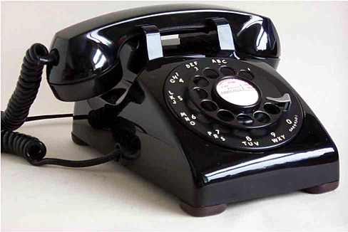
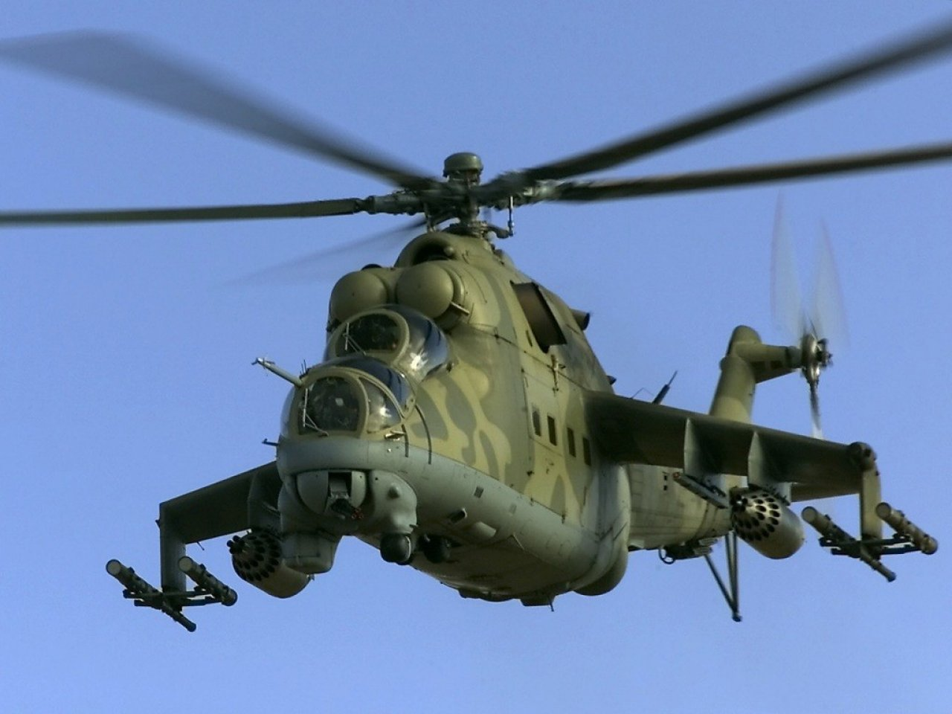
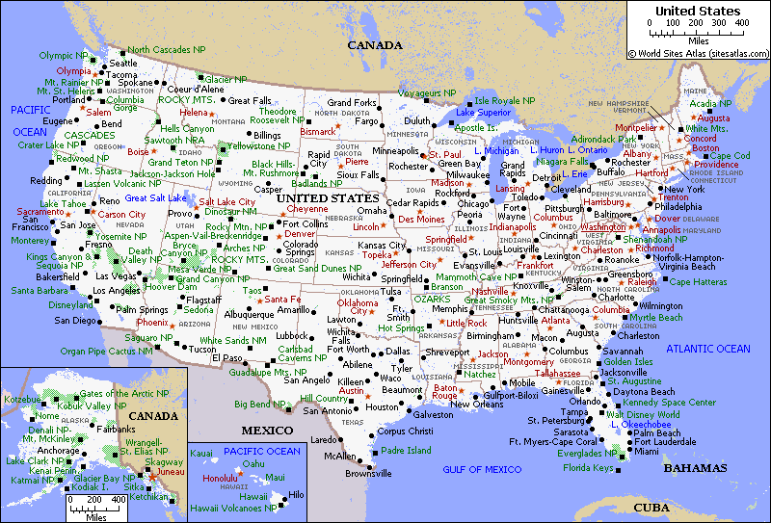
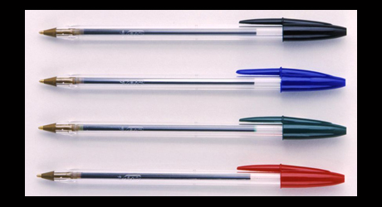
Odd one out

